Slide 1
Predicting if a college basketball player will be drafted to the NBA
By Tyler Evans, Princeton Duarte, AJ Marstall & Emily Andrews

Slide 2

We used player stats from 2009-2021 and analyzed the drafted vs non-drafted players. We were wanting to find out if we can predict who will be drafted to the NBA based on statistics alone.
We first cleaned the data, then visualized the data and lastly, we utilized machine learning.
NOTE:
To change images on this slide, select a picture and delete it. Then click the Insert Picture icon
in the placeholder to insert your own image.

Slide 3
Cleaning the Data
Kaggle Datasource
Dropped several stats that were just provided for drafted players – a clear indicator between drafted and undrafted which would’ve led to overfitting
Dropped columns that had more than 1K nulls
Height column was in date format – transformed to total inches
Grouped by player ID (pid) unique identifier
Jupyter Notebook File
Prior to feeding model data:
Identified and filtered to conferences that had drafted and undrafted players
Filtered out players that played less than 8 games per year and averaged 7.5 mins per game.

Slide 4
Differences between drafted and undrafted players

Slide 5
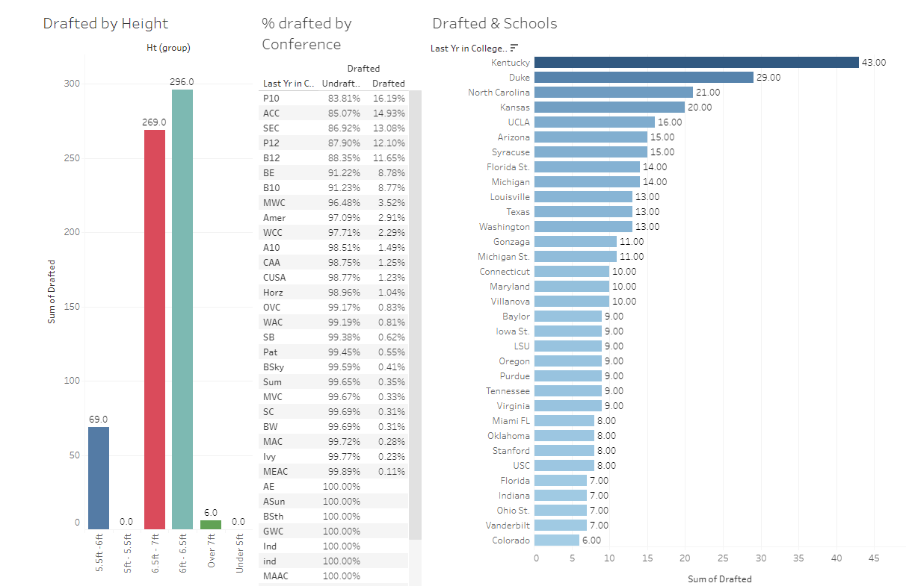
Notes:
Kentucky tends to have the most drafted players in the data we found. And the School with the second most drafted players was Duke which had 14 fewer players drafted than Kentucky.
Drafted players' heights typically are between six feet to seven feet (No surprise there). And sorry no one under five feet five inches was drafted.
Conferences with the schools associated as “Blue Bloods Schools” (Kentucky, Duke, North Carolina, Kansas, and UCLA) tends to have more drafted players than any other Conferences.

Slide 6
Stats that did not help to determine if a player will be drafted

Slide 7
Notes:
Although Schools and Conferences do help in determining whether a player gets drafted. Of the 640 players, the chart shows the spread across all conferences.
The position a player played did not contribute to a player being drafted.
The last year they played in college before being drafted did not contribute to a player being selected.
As for stats that most fans associate with basketball: points scored, assists, and rebounds. There was a slight difference in the average Assists & offensive rebounds and a more substantial difference with defensive rebounds and average points between undrafted and drafted players.

Slide 8

Robots Playing Basketball
Choosing the correct model is highly important.
Having a good usable dataset is just as important as the model.
Sometimes it just comes down to trial and error.
A model that reports as doing very well may not always be doing what you think it should be doing.

Slide 9
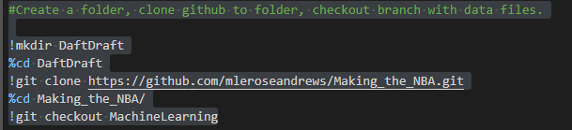
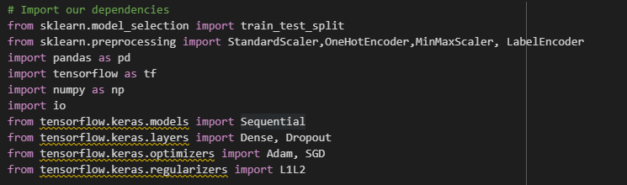
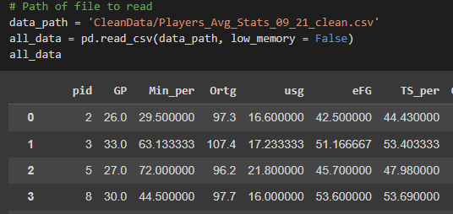
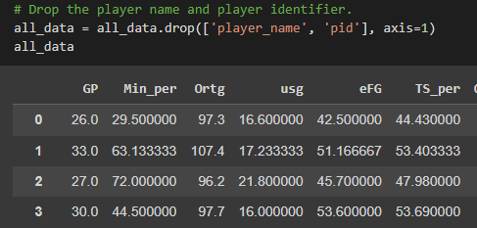
Notes:
Here was have that start of our training data. First we import the github so our folder structure and files are present in Google Collab. Then import our dependencies and the data. Then strip the identifiers from it.

Slide 10
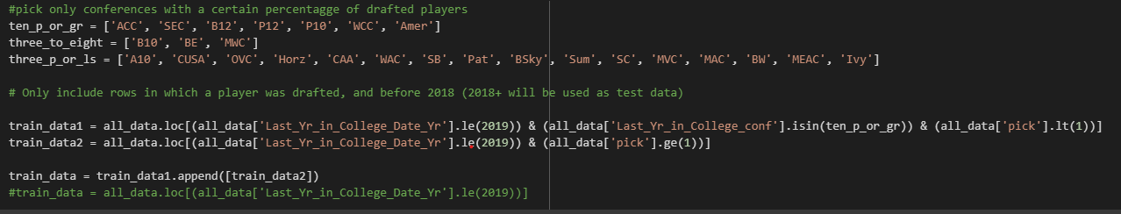
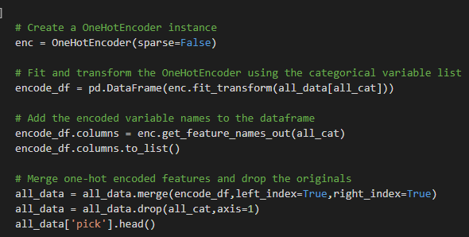
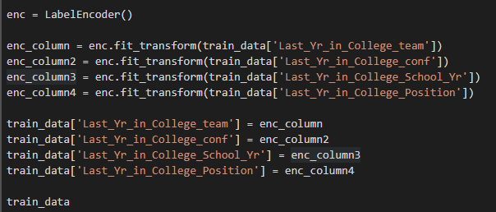
Picking the training data
First method of encoding the data
Better method of encoding the data
Notes:
Ended up choosing conferences with ten percent or more drafted players because the other conferences subsets resulted in too few undrafted players and we ended up with the same problem. Instead of no one going to the NBA, everyone was going to the NBA.
Old method of encoding
This method resulted in around 400 columns of data being generated, which didnt increase computational complexity so much as make the data near impossible to manage afterwards without de encoding it.
New method of encoding
As opposed to the old method, encoding based on label, lets all the data stay in one column exactly how we had it, and instead changes the categorical value to a numeral, making the data much easier to read and manage and verify. 62 columns

Slide 11
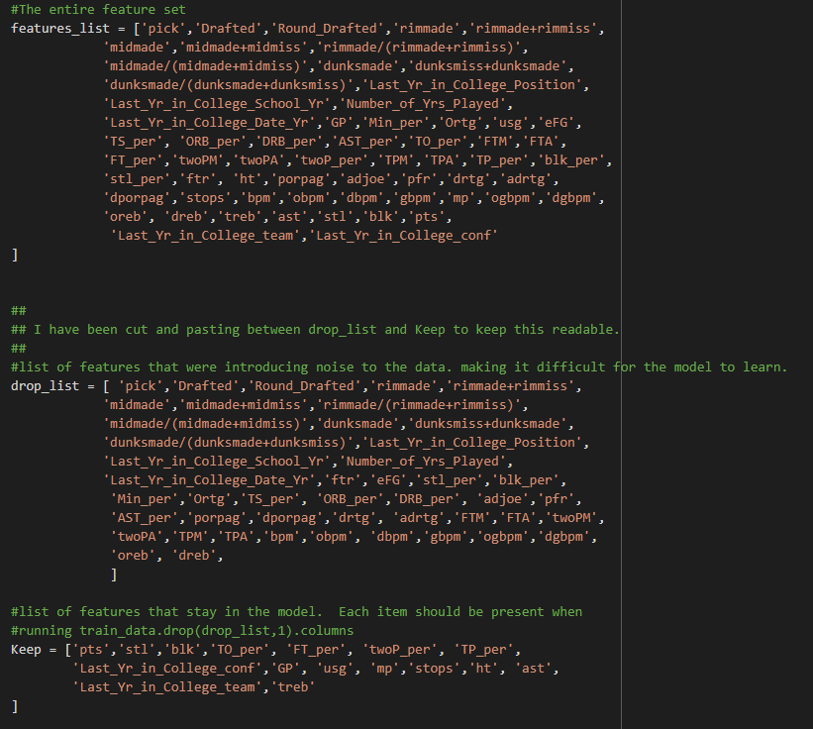
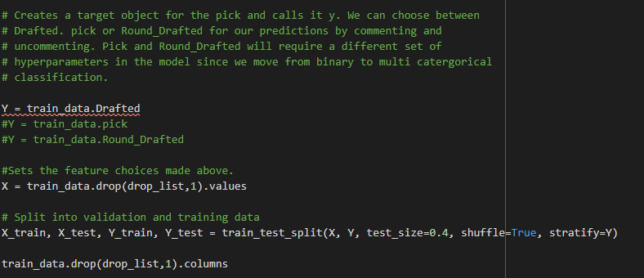
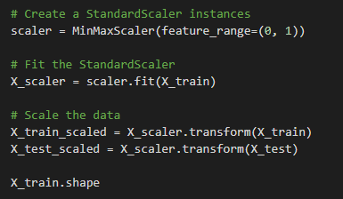
Split ting & Scaling
Notes:
Split it
The lists are for picking our X and dropping the chaff. W went with Drafted/Undrafted for our Y when they are picked doesn't really matter for our ask. When we split, 40% test was the sweet spot, 30% took twice as long to start learning and 50% caused the model to be overfit and not learn at all. Shuffling and Stratifying the data makes sure that we have equity in our train and test Y.

Slide 12
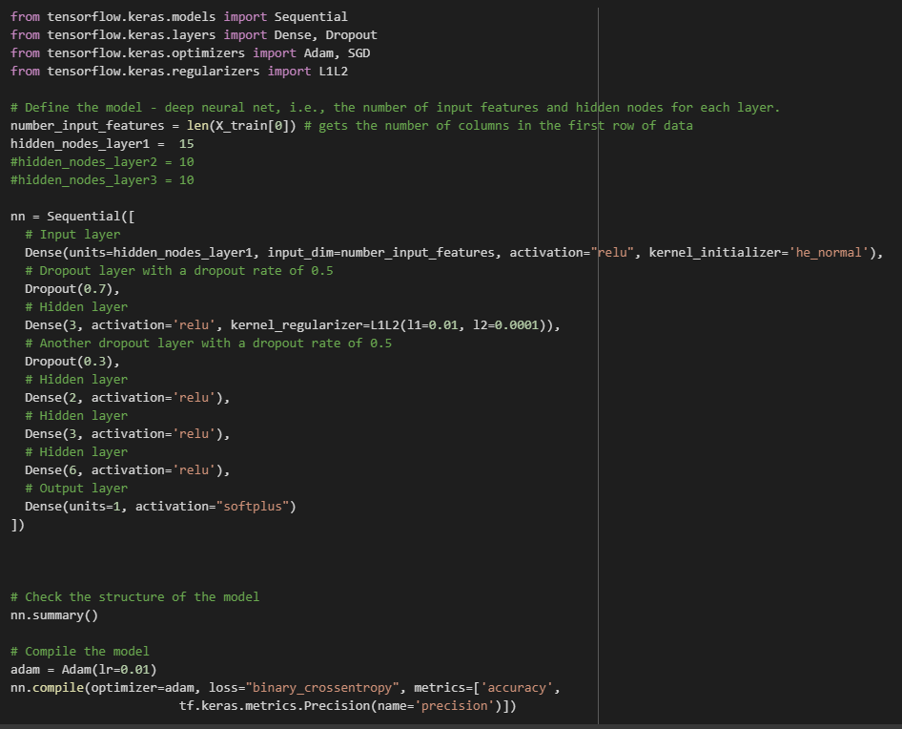
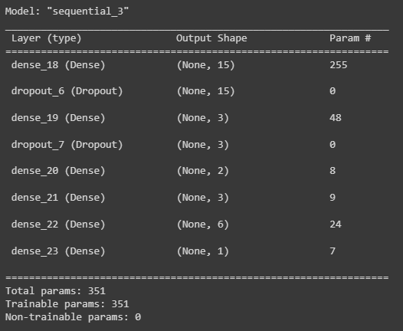
The Robot
Notes:
Using TF.Keras
Building and compiling the model.
After finding this configuration, I began testing different iterations one variable at a time. What was found is that the first iteration was the optimal one, changing one thing in either direction would result in either a slower training model, or the whole model would revert to not learning even after 1000 epochs. The initial layer has seen success with 15 nodes, the kernel initializer was set to reduce the weights before starting to lower than default to reduce overfitting. The same reason we add dropout layers and a kernel regularizer, all to keep the model complex enough to work, but not learn so quickly it just memorizes the data.
The adam optimizer was chosen due it's performance on the loss metric vs other optimizers. The learning rate was set low to help keep the model from converging too quickly and reverting back to not learning anything. Precision was added as a metric due to accuracy being unreliable on it's own with this model. Precision added a much needed visibility into the percentage of correct guesses of Drafted players, where as with the high number of nagatives in the dataset already, the model was achieving 80% accuracy on true/false negatives which left us blind to how the model was performing during training.

Slide 13
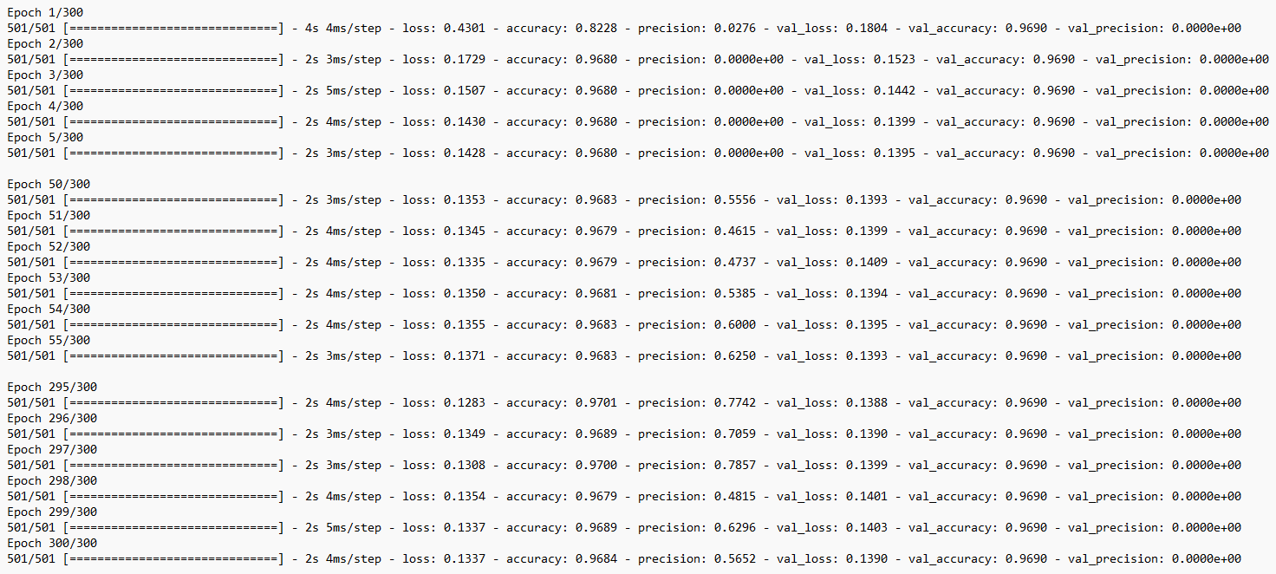
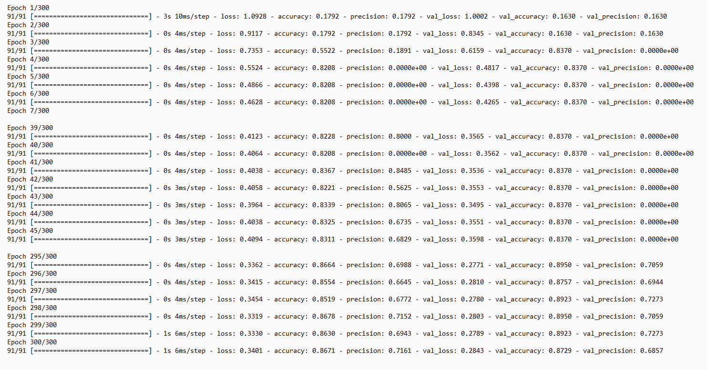
Why Good Data is important.
Before Data Parity
After Data Parity
Notes:
We decided after visualizing the data that separating it based on conference would be beneficial. There was much trial and error before coming to this conclusion where it became suspected that the data was just too prolific in undrafted players that the models could not predict the minority that represented drafted players. With all the stats being so close together the model would just pick that no one would be drafted.
To introduce parity between drafted and undrafted we take all drafted players and only take a subset of undrafted players based on conference.
If you play around with the model, you can see this by uncommenting the second train data variable and running through the testing. I can show it here in image form
What you see is that it very quickly converged to near 100% accuracy and near 0% loss in the first 5 epochs. However, it didn't start making good predictions on known data until around epoch 50 give or take. Skipping to the end, we can see that it never got better at prediction on known values, nor did it ever make a good prediction on an unknown value.

Slide 14
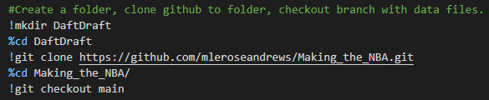
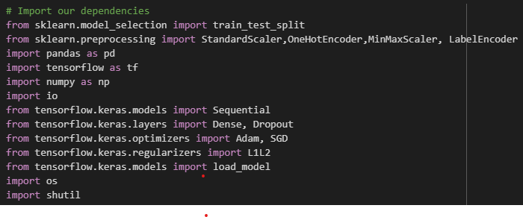
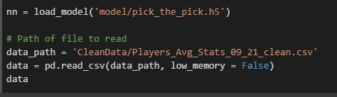
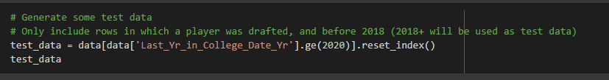

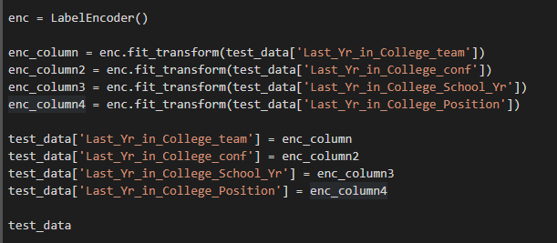
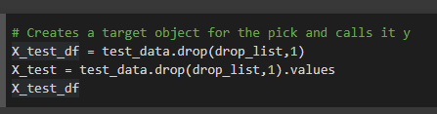
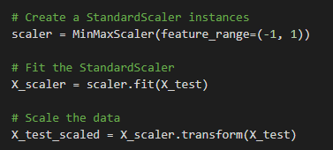

Should we hire the robot.
Import the dependencies again
Pick the test data and save the identifiers.
Here we run the data through the same formatting as before, encoding categorical data, dropping bad columns and scaling.
TESTED!

Slide 15
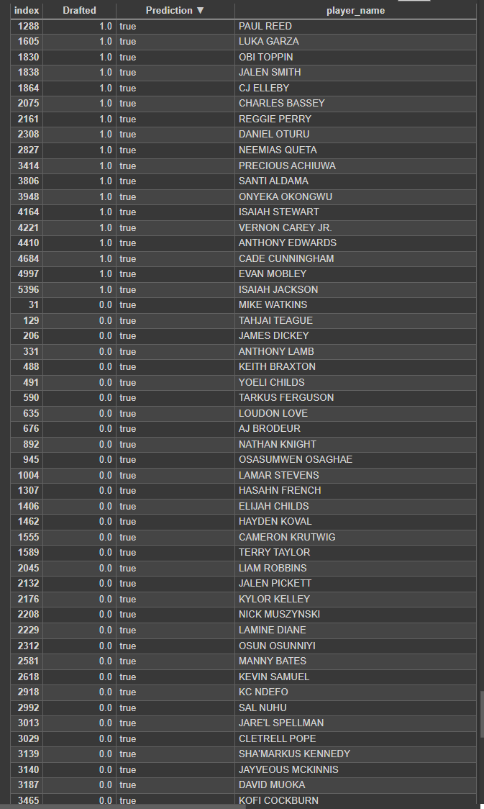
No.
38/38 - 0s - loss: 0.2720 - accuracy: 0.8814 - precision: 0.7949 - 80ms/epoch - 2ms/step Loss: 0.2720300853252411, Accuracy: 0.881426215171814, Precision: 0.7948718070983887
Confidently wrong is an understatement.
The NN was able to accurately predict 18/120 drafted players. 42/60 of the predictions were false positives. This, all the while itself reporting an accuracy and precision of 80-90%

Slide 16
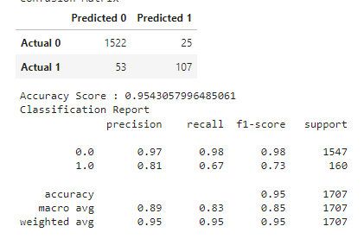

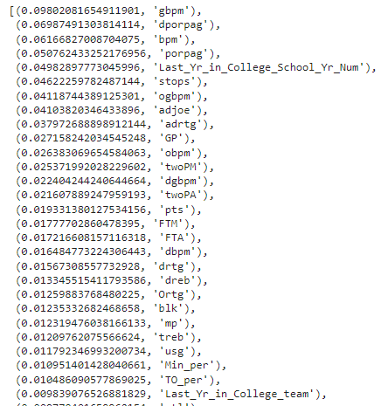
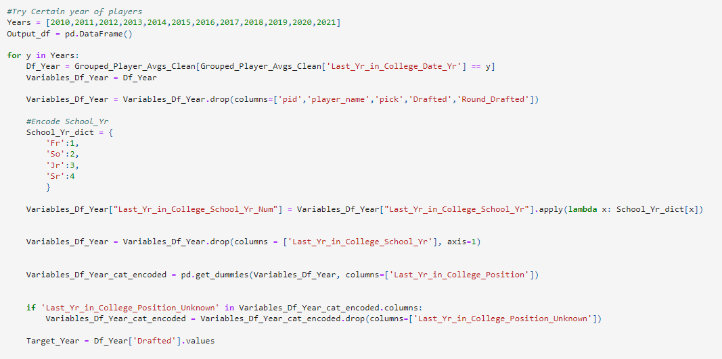
K.I.S.S

Slide 17
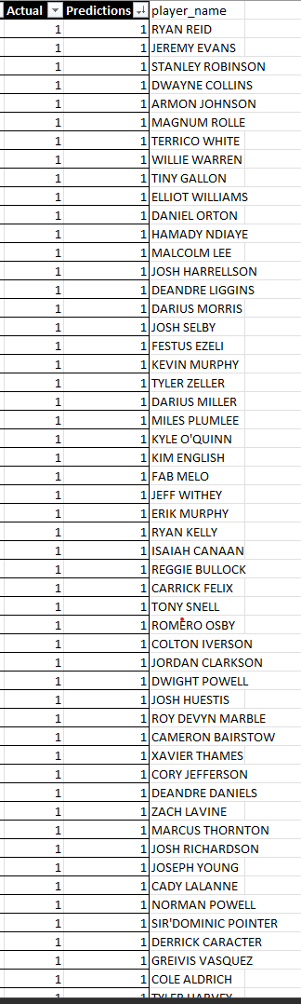
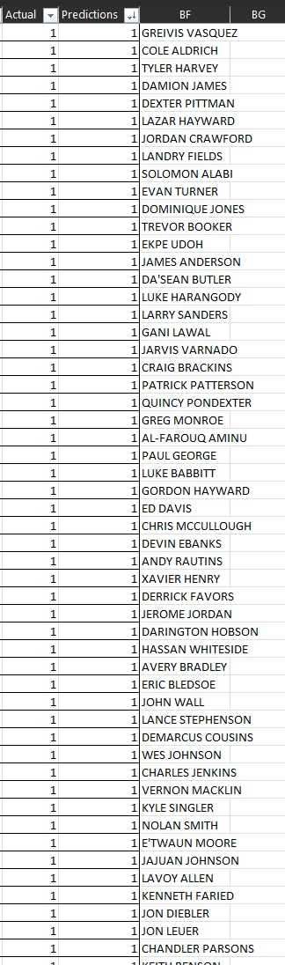
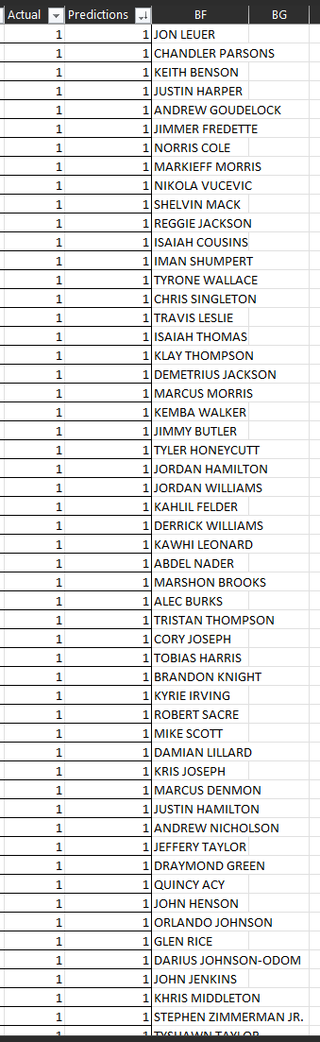
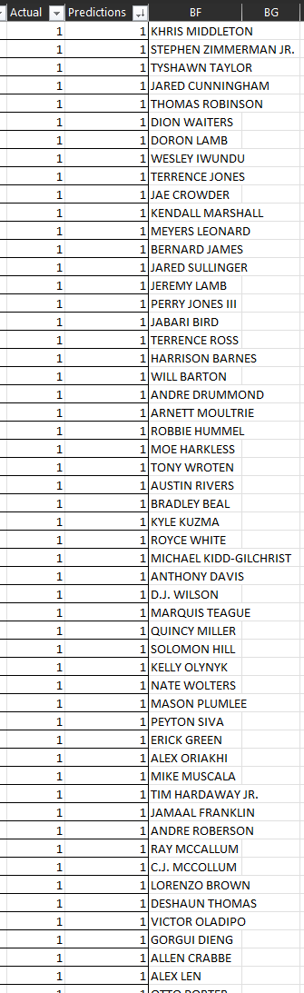
482 correct drafted players predicted with half as many false positives.
While still not perfect, it is leaps and bounds better than the NN performed.
This model also had the benefit of taking less time to put together and troubleshoot than the NN.

Slide 18
Lessons Learned
The data was not meant for a NN, but was simple enough that a simpler ML model was able to use it.
While the data set seemed large at first with richness in the data. It ultimately showed that a lot of the stats were just variations of other stats already present.
Having so few positives (2% of drafted players) proved difficult to work with.
Each draft year is specific to the needs of the NBA
With unlimited time what would we change?
Looked at stats that are more position specific. i.e. Compare all point guards
Look at the data year by year instead of having all the years combined.
Search for more robust data points. i.e. Degree program, health, homelife, hobbies, etc.

Slide 19
Questions??

